Slide 1

Power Platform Basics
Notes:
This deck is a template for What The Hack lectures.
It is recommended that Coaches deliver mini-lectures ahead of each Challenge that set context for the challenge and introduce & explain any key technologies.
At a minimum, it is handy to have a slide with the key goals of each challenge to display on the screen when running the hack in-person.

Slide 2

Power Platform Basics
Welcome & Intros
Nghiem Doan
Sherry Xu
Sr Cloud Solution Architect
Sr Cloud Solution Architect
Behnaz Majidi
Trinh Tran
Workplace automation Developer - Softchoice
Sr Partner Tech Strategist
Tad Thompson
Sr Cloud Solution Architect
Notes:
Coaches/Presenters for THIS hack/lecture event should be listed on this slide.
Original contributors to the hack content & these slides include:
Please list original contributors to this hack here in the speaker notes and give them credit when delivering this content.
<Original Author 1>
<Original Author 2>
…
<Original Author N>

Slide 3
What is Power Platform?

Slide 4
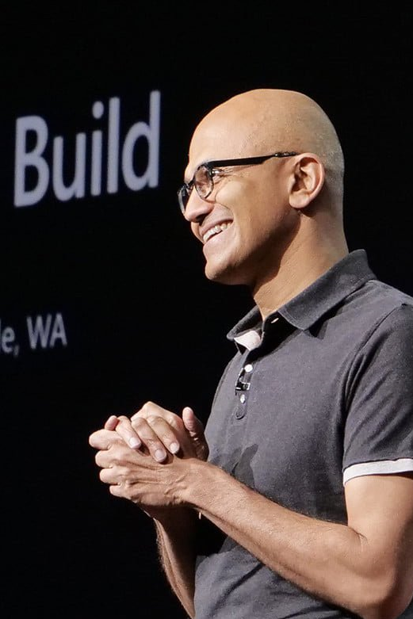

“Microsoft 365, Dynamics 365, and the Power Platform, on top of what we’re doing with Azure, is the core of what we are doing as a company.”
--Satya Nadella CEO, Microsoft
Notes:
Power Platform is one of the core pillars that Microsoft is investing in today – receiving major attention and investment throughout the organization and being at the center of all three Microsoft clouds – M355, Azure and D365.

Slide 5
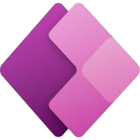

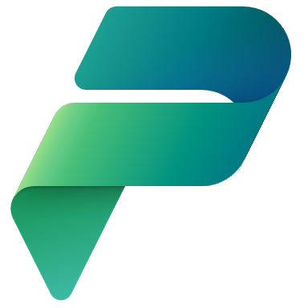


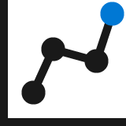



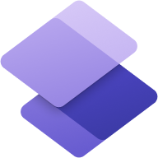
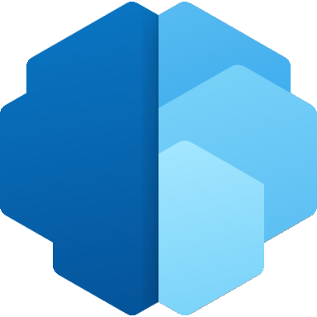
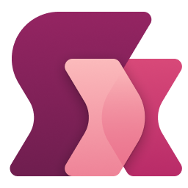
Power Platform: Everyone’s platform for transformation
Power Apps
Drive business processes
Improve engagements with customers and employees
No Code
Drag and drop experiences that are like PowerPoint
Power Automate
Power Virtual Agents
Low Code
Drag and drop plus Excel-like formulas for functionality
Automate response metrics
Analyze data from apps and bots
Power BI
Code First
Professional development and extensibility across Microsoft
Dataverse
Power Pages
AI Builder
Power Fx
Notes:
Power Platform is a unified platform of low-code tools that spans Office 365, Azure, Dynamics 365, and standalone applications helps you analyze data, build solutions, automate processes, and create virtual agents to transform your business. Power Platform is a rapid application development platform that enables citizen developers with limited coding abilities to innovate and build new solutions faster in an environment and user experience that feels like PowerPoint and Excel.
Additionally, Power Platform is a rapid application development and extensibility framework for professional developers. For the professional developer, Power Platform is the rapid application development platform and extensibility platform of choice because it seamlessly integrates the high-speed capabilities of low-code tools and prebuilt components with no-cliffs extensibility across Azure and other professional development environments.
Power Platform is a transformative solution because it enables all kinds of developers and employees to collaborate and build solutions – whether no code, low code, or code first.

Slide 6
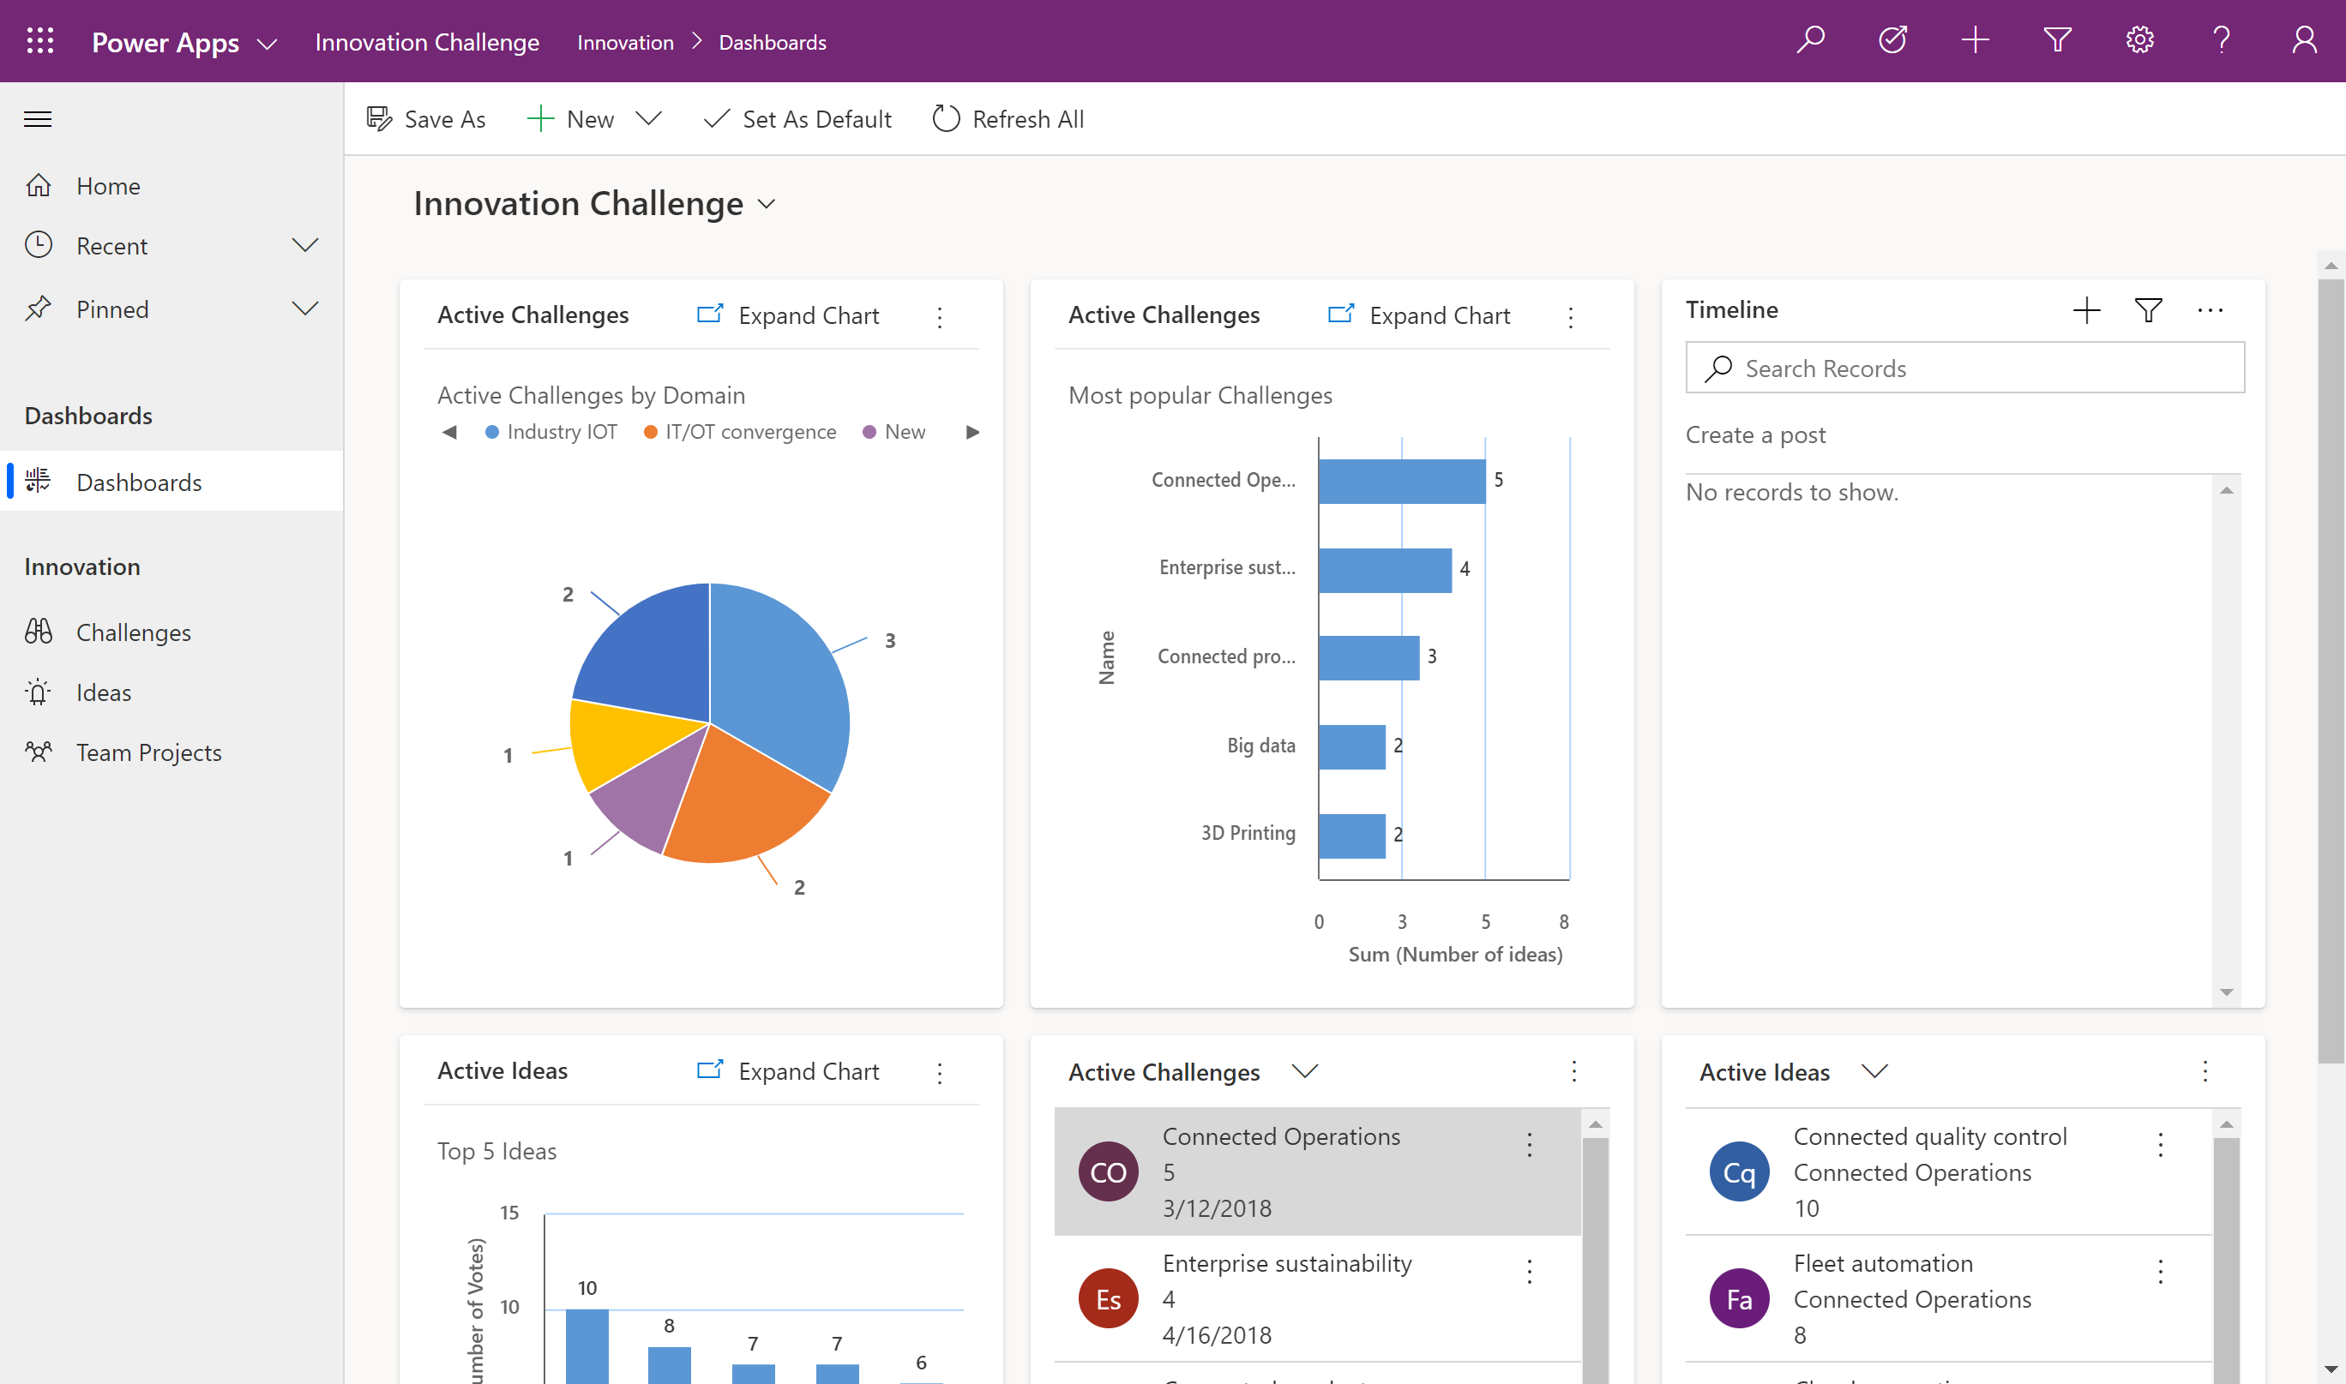

Power Apps Empower everyone to create apps
Use Power Apps to rapidly create web and mobile front ends using a drag and drop UI.
Build once and deploy apps in one click across iOS, Android, Windows, and Web.
Customize every detail of an app to optimize for specific tasks, roles, and industries.
Enable pro developers to create re-usable components to share with citizen developers.
Connect to data using pre-built or custom connectors.
Drag & drop your screenshot here or click or tap icon below to insert
Notes:
With Microsoft Power Apps, anyone can quickly build and share low-code apps. Citizen developers and pro developers alike can build low-code apps that modernize processes and solve tough challenges. These solutions help increase agility across your organization and empower your teams to build solutions to everyday problems.
With Microsoft Power Apps, you can leverage prebuilt templates, drag-and-drop simplicity, and quick deployment to allow your citizen developers to build the applications they need with advanced functionality – something that they earlier had to rely on professional developers for.
Additionally, with Power Apps you can provide your professional developers the tools to seamlessly extend application capabilities with Azure Functions and custom connectors to connect to hundreds of data sources, including pre-built AI components.
Lastly, with Power Apps you can build powerful end-to-end business solutions by connecting Power Apps across the entire Microsoft Power Platform, to Office 365, Dynamics 365, Azure, and hundreds of other apps to drive innovation across your business.
By deploying Power Apps, businesses are reducing app development costs by 74% and increasing overall efficiency using Power Apps as shared in this Total Economic Impact commissioned study for Forrester Consulting in March 2020. https://go.microsoft.com/fwlink/?LinkId=2126953&clcid=0x409

Slide 7
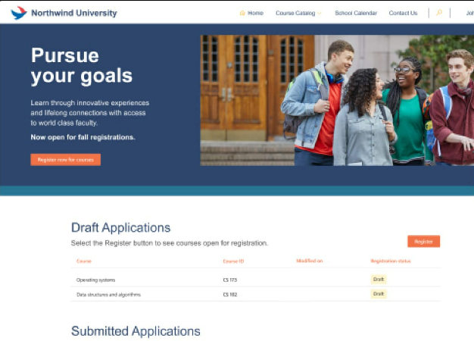
Power Pages Empower everyone to create websites
Use Power Pages to rapidly create secure, low-code business websites.
Securely store and manage your data in Microsoft Dataverse.
Get started quickly with templates that are ready to go, out of the box.
Create pixel perfect sites in the design studio allowing complete control over every aspect of design.
Build with pro tools and give developers the ability to add rich functionality in Visual Studio Code, Github, and Azure DevOps.
Drag & drop your screenshot here or click or tap icon below to insert
Notes:
With Microsoft Power Apps, anyone can quickly build and share low-code apps. Citizen developers and pro developers alike can build low-code apps that modernize processes and solve tough challenges. These solutions help increase agility across your organization and empower your teams to build solutions to everyday problems.
With Microsoft Power Apps, you can leverage prebuilt templates, drag-and-drop simplicity, and quick deployment to allow your citizen developers to build the applications they need with advanced functionality – something that they earlier had to rely on professional developers for.
Additionally, with Power Apps you can provide your professional developers the tools to seamlessly extend application capabilities with Azure Functions and custom connectors to connect to hundreds of data sources, including pre-built AI components.
Lastly, with Power Apps you can build powerful end-to-end business solutions by connecting Power Apps across the entire Microsoft Power Platform, to Office 365, Dynamics 365, Azure, and hundreds of other apps to drive innovation across your business.
By deploying Power Apps, businesses are reducing app development costs by 74% and increasing overall efficiency using Power Apps as shared in this Total Economic Impact commissioned study for Forrester Consulting in March 2020. https://go.microsoft.com/fwlink/?LinkId=2126953&clcid=0x409

Slide 8
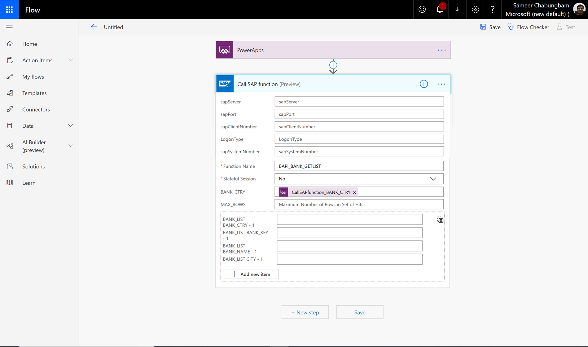
Power Automate Automate business processes across Power Platform
Expand and improve business processes with integrated RPA workflows.
Send automatic reminders for past due tasks.
Move business data between systems on a schedule.
Connect to over 300 other data sources or any publicly available API.
Create a flow once and enable makers to use it across the Power Platform.
Notes:
Automation takes a new meaning with Power Automate, which enables users to model business processes across your applications and services with an easy to use and efficient Power Platform product.
With Power Automate, citizen developers interacting with legacy applications can create RPA-driven automation solutions that extend and innovate on top of existing legacy systems to modernize legacy business processes.
Users can also automate repeatable, low value-added manual processes and workflows and spend more time on higher value-added work. In short, take care of what’s important and automate the rest.
Whether it is building time-saving workflows like setting automatic reminders for past due tasks or moving business data between systems on a schedule, Power Automate allows you to streamline repetitive tasks and paperless processes and turn outdated into automated.
Seamless integration using hundred of prebuilt connectors helps you save time and boost productivity and empowers everyone to build secure workflows with a low-code, no-code guided experience to automate routine tasks with robotic process automation (RPA).
In short, drive business transformation with Power Automate and reduce development costs and increase overall efficiency of your workforce. The Total Economic Impact study conducted by Forrester Consulting in April 2020 found that increased automation reduced time-to-market by as much as 33% in surveyed companies.
https://info.microsoft.com/ww-landing-forrester-TEI-of-power-automate.html

Slide 9
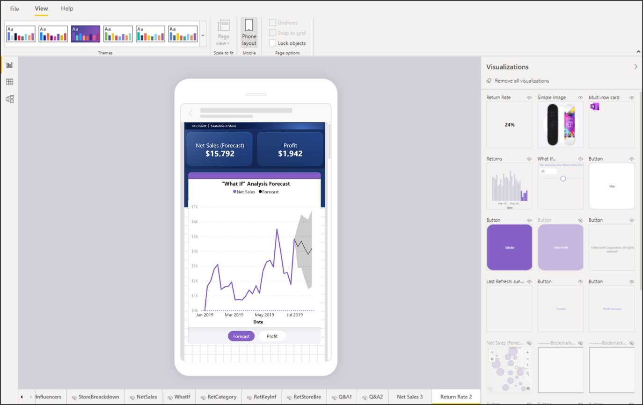
Power BI AI infused experiences with the familiarity of Office
Enable everyone to create real time dashboards & interactive reports using low-code tools and pre-built formats.
Empower end-users to explore and personalize visuals based on their unique needs.
Add dynamic, interactive narratives to reports with the flexibility to edit language and format.
Notes:
Not all workers across teams are equipped with the skills to understand data and discover actionable insights hidden in your data that can drive business results. Microsoft Power BI enables you to create a data-driven culture where everyone in your organization can make confident decisions with real-time analytics.
Power BI offers capabilities to help you discover and explore insights from your data including automated machine learning for predictive modelling, new AI visualizations with decomposition trees for detailed root cause analysis drill downs, and easier ways for everyone to interact with their data using the new Q&A visualization.
With Power BI, you can reduce added costs, complexity, and security risks of multiple solutions with an analytics platform that scales across your organization.
Hundreds of data visualizations, built-in AI capabilities, and prebuilt custom data connectors help team members create real-time dashboards and interactive reports leveraging familiar tools such as PowerPoint and Excel.
With Power BI, you empower everyone with the tools to be a data hero, finding and sharing transformative insights that impact your business. The Total Economic Impact report by Forrester Consulting explores how organizations capture a 366% return on investment, leveraging Power BI. https://go.microsoft.com/fwlink/?LinkId=2133415&clcid=0x409

Slide 10

Power Virtual Agents Automate business processes across Power Platform
Create and manage powerful chatbots – without the need for code or AI expertise – with an easy-to-use graphical interface.
Easily integrate your chatbots with the products and services you use every day.
Look up records, personalize conversations, hand off conversations to live agents, and call APIs.
Choose from hundreds of prebuilt connectors, build custom workflows using Power Automate, or create complex scenarios with Microsoft Bot Framework.
Monitor and improve your chatbot’s performance using AI and data-driven insights.
Notes:
Easily building intelligent chatbots is accessible and doable for more than just professional developers with advanced technical knowledge. Microsoft Power Virtual Agents empowers everyone to do it easily, no coding required.
Power Virtual Agents empowers teams to easily create powerful bots using a guided, no-code graphical interface without the need for data scientists or developers. It eliminates the gap between the subject matter experts and the development teams building the bots, and the long latency between teams recognizing an issue and updating the bot to address it.
Chatbots can easily be integrated with the products and services teams use on a daily basis. Team members can choose from hundreds of prebuilt connectors, build custom workflows using Power Automate or even create complex scenarios using Microsoft Bot framework.
Drive organizational productivity with Power Virtual Agents and reduce operational burden on HR and helpdesk. A commissioned study conducted by Forrester Consulting, June 2020, found that use of bots to handle employee questions reduces the number of IT and HR support tickets by 10% to 15%. https://go.microsoft.com/fwlink/?LinkId=2142077&clcid=0x409

Slide 11
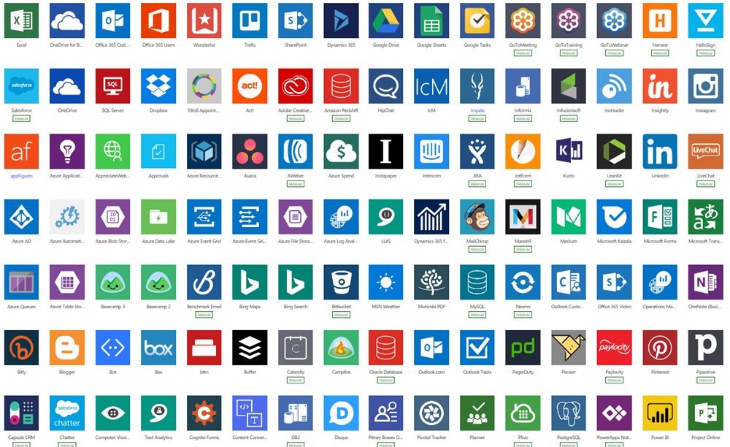
Pre-built connectors Connect to Microsoft and third-party data sources with ease
Built-in connectivity to 700+ cloud services, content services, databases, APIs, etc.
Seamless hybrid connectivity to on-premises systems via the on-premises data gateway.
Develop and register custom connectors as a building block for citizen developers.
Connect data silos by using multiple data sources in a single application.
Connect data silos by using multiple data sources in a single application.
Notes:
There are 300+ connectors that make it easy for application builders to connect to both Microsoft and 3rd party services, from Dynamics 365 to Dropbox. The connectors allow canvas apps and flows to easily use API (application programming interfaces) services without any developer knowledge. Custom connectors can also be configured to allow use of APIs that aren’t covered by the public connectors.
Connectors are essentially proxy wrappers around the application programming interfaces (APIs) provided by services that allow Power Automate, Power Apps and Logic Apps to easily interact with the service. Connectors can be either public or custom. There are currently over 300+ public connectors that can be used by all organizations. Examples of public connectors are Microsoft 365 (formerly Office 365), Common Data Service, Salesforce, SAP and more.

Slide 12
AI Builder Low-code AI for apps and processes
Low-code AI solutions for Power Platform leveraging the power of Azure AI.
Native integration with Common Data Service enables data from Dataverse, Azure Data Lakes.
Leverage predictions directly from Common Data Service across your Power Platform solutions, Dynamics 365, or Microsoft 365.
Prediction
Vision
Vision
Language
Binary classification
Predict and classify fields in Dataverse.
Forms processing
Extract structured data from digital paper, PDFs, and forms.
Object detection
Detect any object (via custom training) through camera or image control.
Text classification
Classify, group and categorize any text in Dataverse.
Notes:
AI Builder is a platform capability that allows easily adding AI to Power Automate, Power Apps and Dynamics 1st Party Apps. This enables makers to automate tasks and predict outcomes without having to involve data scientists.

Slide 13
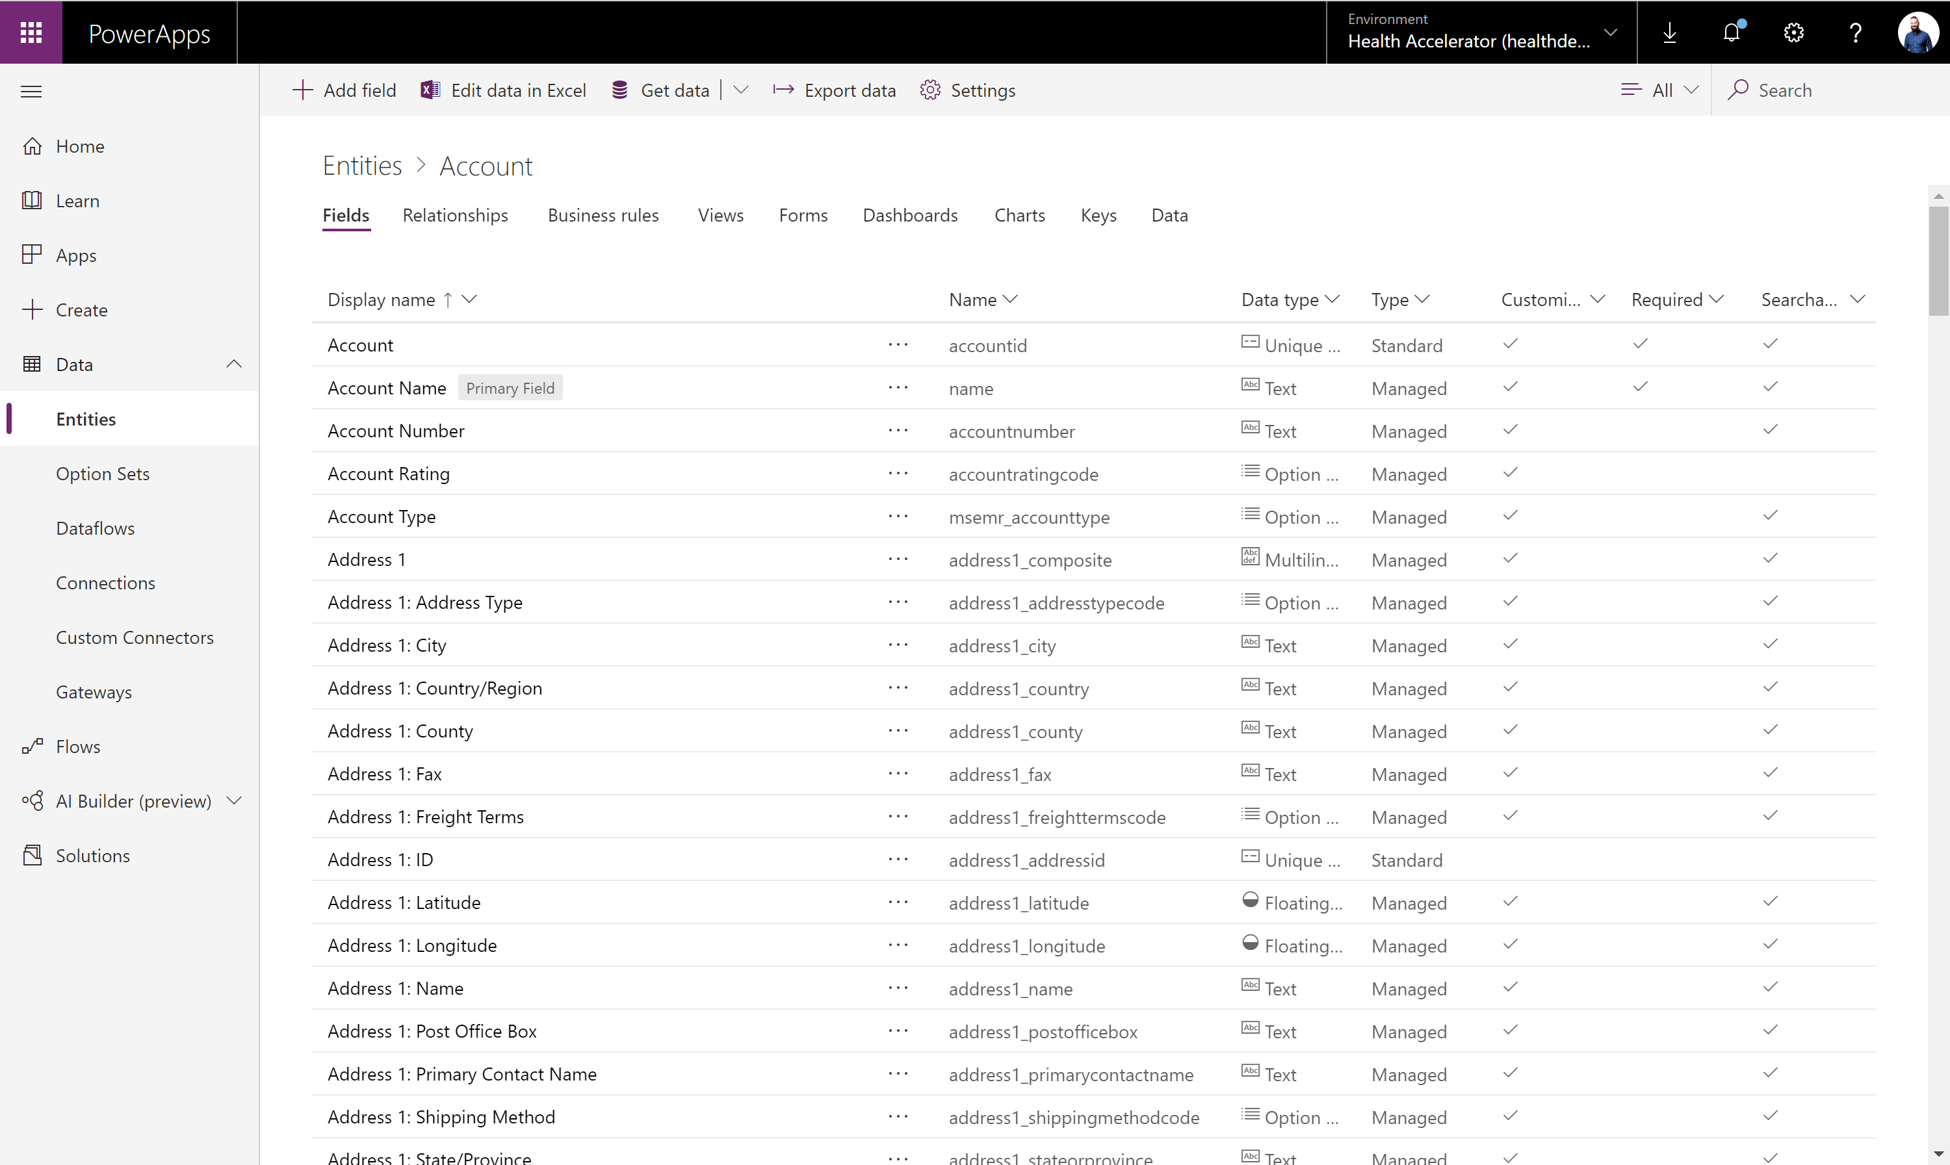
Dataverse Put all your data to work
Jumpstart apps using an extensible data model with business logic, security and integration built in.
Extend data and processes to external and anonymous users with Power Apps portals.
Support all your data: relational data, file and blob storage, logs and search indexing.
Effortless Dynamics 365, Office 365 and Azure integration as well as powerful integration capabilities.
Notes:
A mature data platform to manage data used by business applications, Dataverse is the platform that sits under the Dynamics 365 Sales, Service and Marketing business applications and is offered as a service to the Platform. An initial schema is defined by the Common Data Model. Dataverse provides built-in capabilities for business rules, workflows, calculated and rollup fields and more. Dataverse secures data using a configurable security model, that offers hierarchical, row level and field level security and auditing capabilities.
The Common Data Service (Dataverse) is a mature data platform used to securely store data for business applications built on Power Apps. Dataverse is an abstraction on top of underlying Azure cloud data management services to make it easier to build business applications. Dataverse provides not just data storage, but a way to implement business logic that enforces business rules and automation against the data. Data in Dataverse is organized as entities, for example account and contact would be two examples of entities. These entities can have relationships that define the business connection between the data stored in an entity. For example, John is the primary contact for Contoso would be expressed as a relationship from account to contact. The security model of Dataverse enables data protection down to the field level on individual records. A more thorough discussion of security will be covered in the security section of this paper.
Dataverse databases are created in the context of a Power Platform environment. Each environment can have only a single Dataverse database. Dataverse databases can be provisioned by you or licensed individuals in your organization to support their custom applications. A Dataverse databases is automatically provisioned when a Dynamics 365 Customer Engagement application is added to your tenant. The Dataverse language and currency settings cannot be changed afterwards, enterprise organizations that operate in multiple regions should align on a base language and base currency.

Slide 14
Power Platform is everyone’s platform for low-code transformation

Slide 15
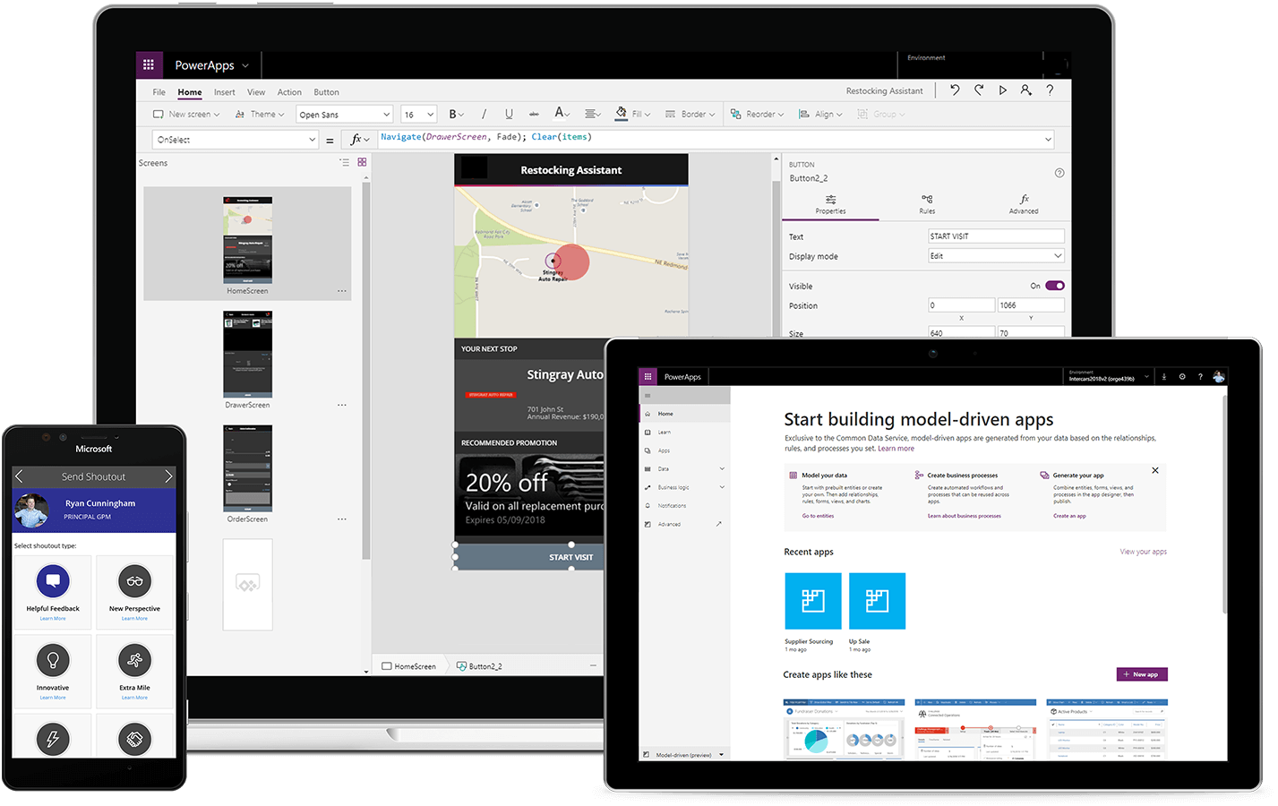



Power Platform: An intuitive, flexible, platform of low-code tools
Drive low-code transformation
Build solutions faster by exposing technology and data to more people through a safe, governable environment.
Empower everyone to imagine, build, and launch solutions
Empower everyone to create innovative business solutions in hours - not months – with familiar tools.
Unlock developer productivity and innovation
Empower developers to build solutions faster and at-scale while using preferred development environments.
Define a new collaboration model
Increase collaboration between business and IT teams and inject more flexibility into your organization.
Notes:
Microsoft Power Platform is an intuitive, extensible platform of low-code tools that empowers all users to collaborate and build transformational solutions. Break up silos and democratize access to technology and data. Surface insights and create flexibility in business processes. Proactively create innovative, scalable solutions. All in the secure, trusted Microsoft Cloud.
With Microsoft Power Platform, you can build solutions on top of legacy systems, cloud-based data or any other data source. You can empower the people closest to the problem — business users, citizen developers — to solve problems themselves by building low-code apps, workflows, data solutions as well as customizations and extensions to M365 and D365. You can also enable professional developers, data scientists, IT teams and others to develop business solutions faster, cheaper and while continuing to use their preferred tools, languages and development environments. With Power Platform everyone, regardless of their technical capability, can work together on the same platform – speaking the same language – to create solutions with a high level of agility.
Not only is Power Platform a turnkey solution that is helping businesses face structural shifts and ensure business continuity, it is empowering businesses to do more with low-code transformation.

Slide 16
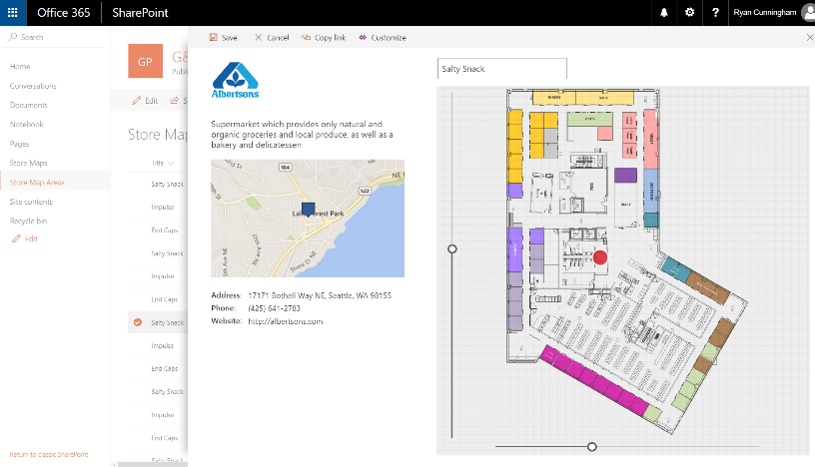
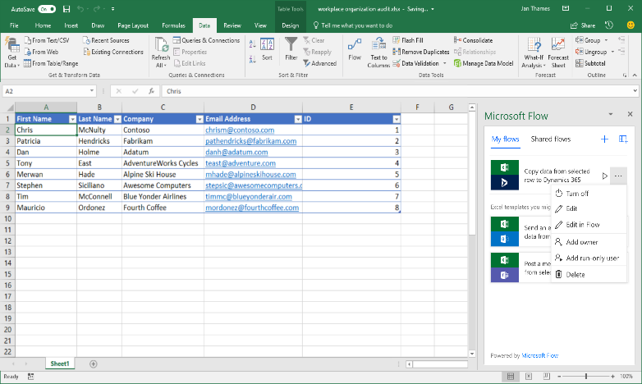
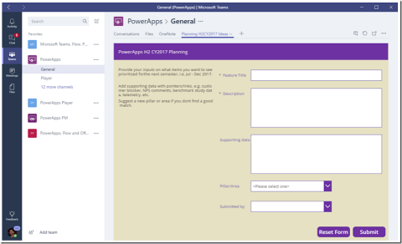
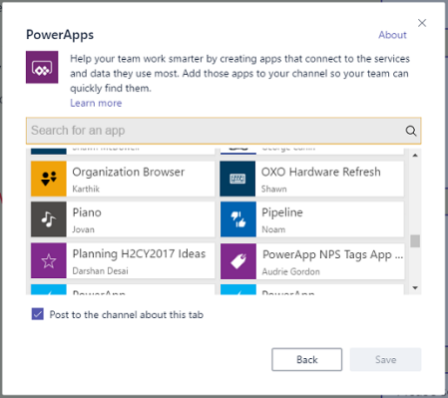
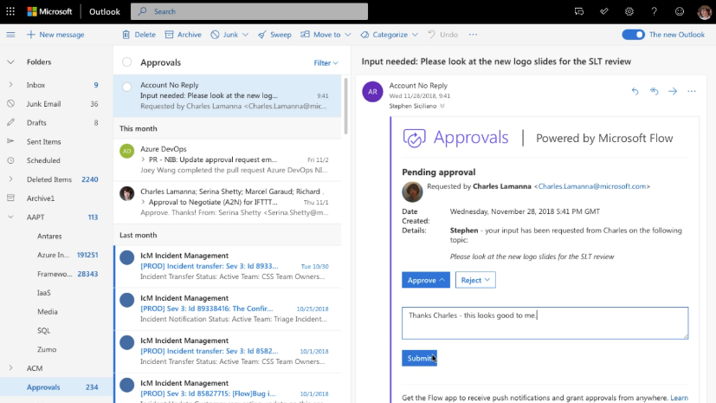
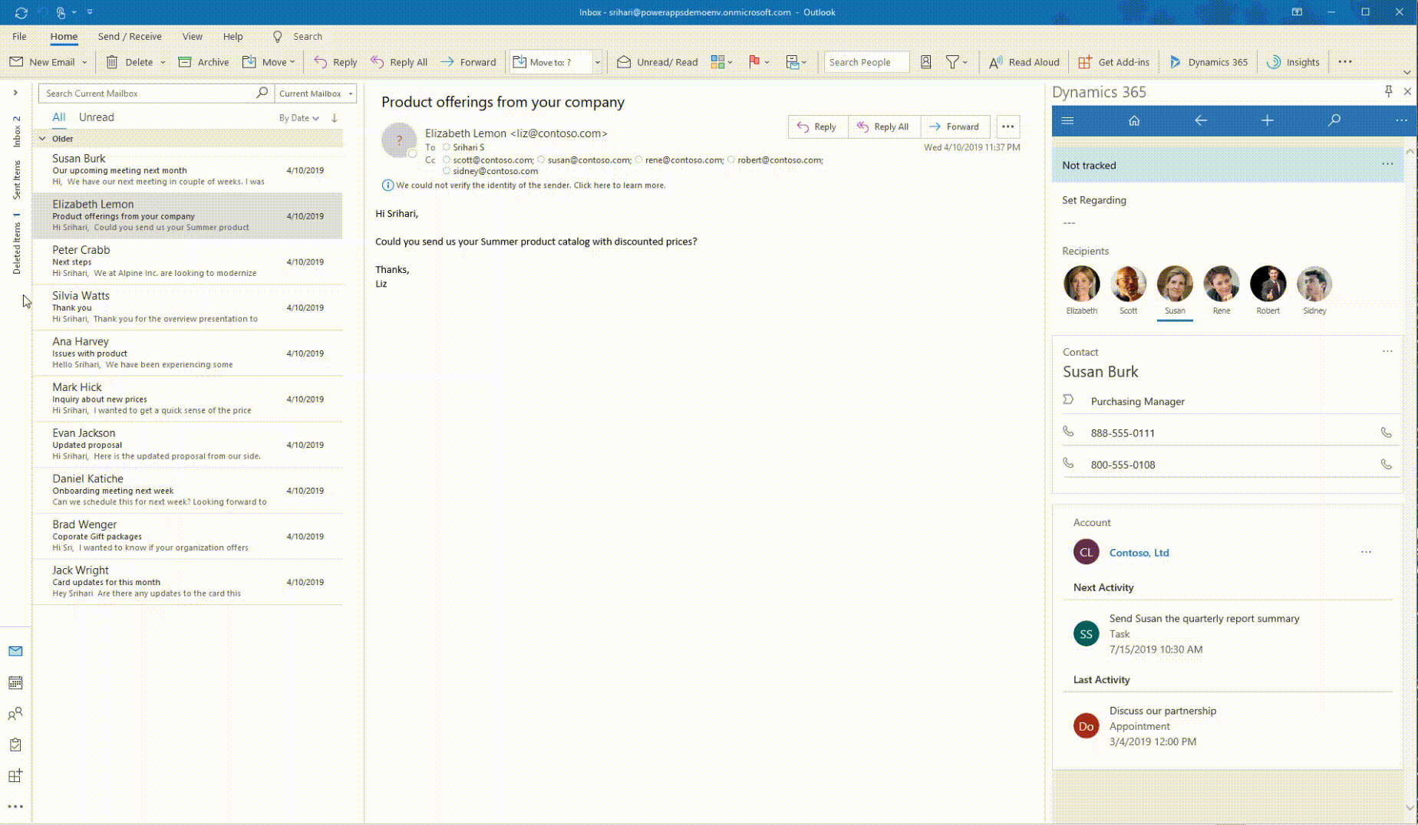
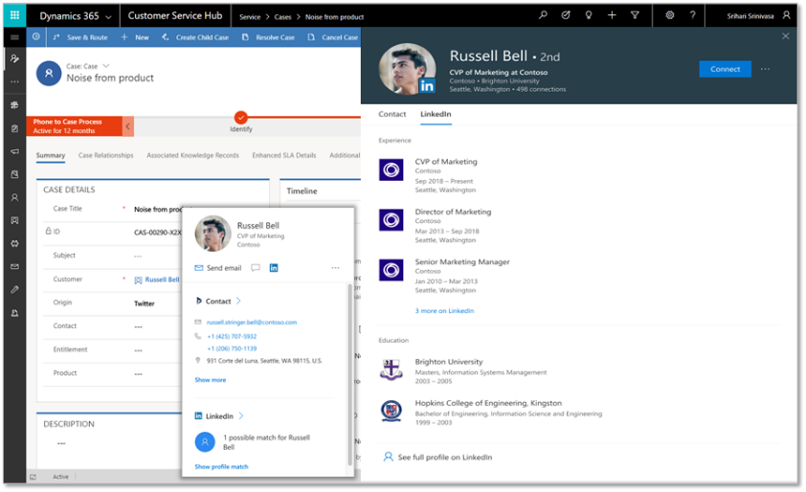
Power Platform + Microsoft 365
Publish Power Apps as a SharePoint web part or create a custom SharePoint list experience
Build a Power Apps app from an Excel sheet or automate on an Excel sheet with Power Automate
Customize a tab with Power Apps or automate a bot or process with Power Automate
Use O 365 data through built-in connectors and Office 365 screen templates
Bring data from Dataverse and Power Apps UX to Outlook with the Mail App (WIn32, OWA, and mobile)
Office 365 People Card in Power Apps + Dynamics (incl. LinkedIn info)
Notes:
With the Microsoft Power Platform, you can easily build low-code productivity solutions in Office 365. Citizen developers and professional developers alike can develop custom solutions that are secure and scalable. Weather in Excel, Outlook or even Teams, creators of all skill levels can leverage the Power Platform to automate tasks, create applications that replace manual or paper based, processes, and other capabilities with Power Platform.

Slide 17
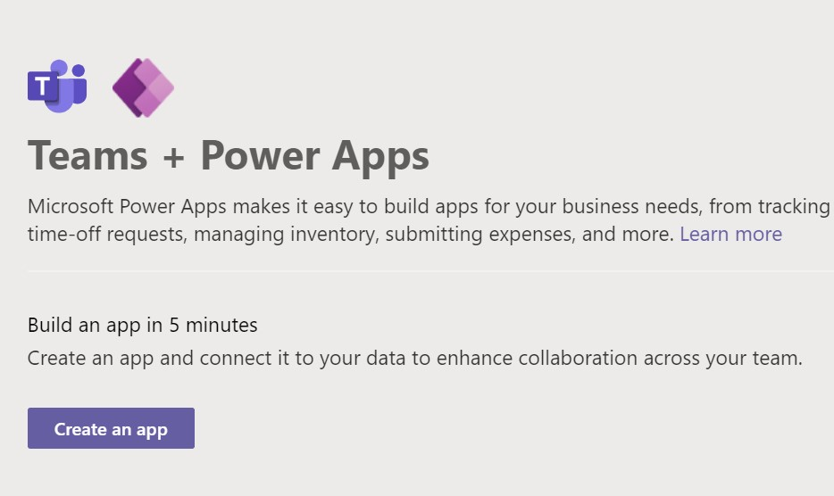
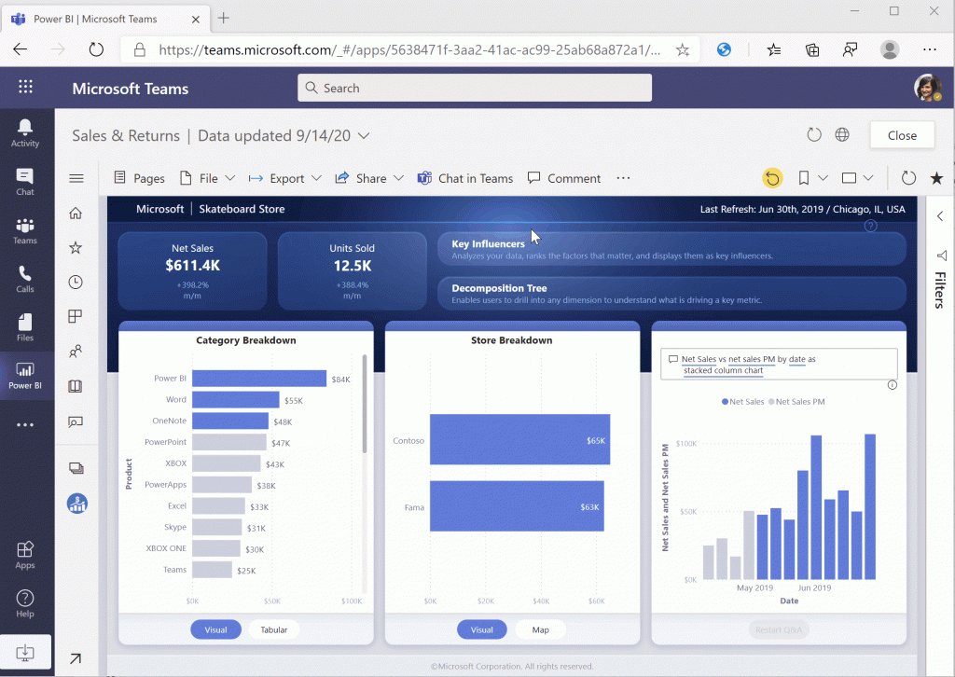
Power Platform integration with Microsoft Teams
Leverage the rich Teams environment to accelerate growth
Leverage the dedicated Power BI add-in application for Microsoft Teams to browse reports, dashboards, and workspaces
Directly embed links to Power BI applications in Teams channel chats and browse Power BI datasets for analyzing data and generating reports
Utilize the Power Apps app in Teams to create canvas apps within Teams backed by Project Oakdale to build custom apps, bots, and workflows
Integrate business data from a wide variety of sources, including Dataverse, embedding a canvas app as a tab app in Teams via PowerApps tab for Teams
Notes:
With the rise of a remote everything world, Teams has become a major place where work gets done. From collaboration and meetings to ongoing workspaces and communication channels, Teams is the hub of productivity.
Augment with Power BI integration with Teams also.
This integration of Power Platform and Teams, named Project Oakdale, delivers a built-in low code data platform for Microsoft Teams, and provides relational data storage, rich data types, enterprise grade governance, and one-click solution deployment.
Microsoft Teams and the Power Platform is shaping the future of work with low-code apps to run the business. The new functionality enables users to easily build applications and bots directly within Teams, empowering business users to rapidly respond to changing business needs and create custom solutions. With the addition of Project Oakdale, Teams users now have key business data at their fingertips to build new apps that address real business problems—all without ever leaving Teams.

Slide 18

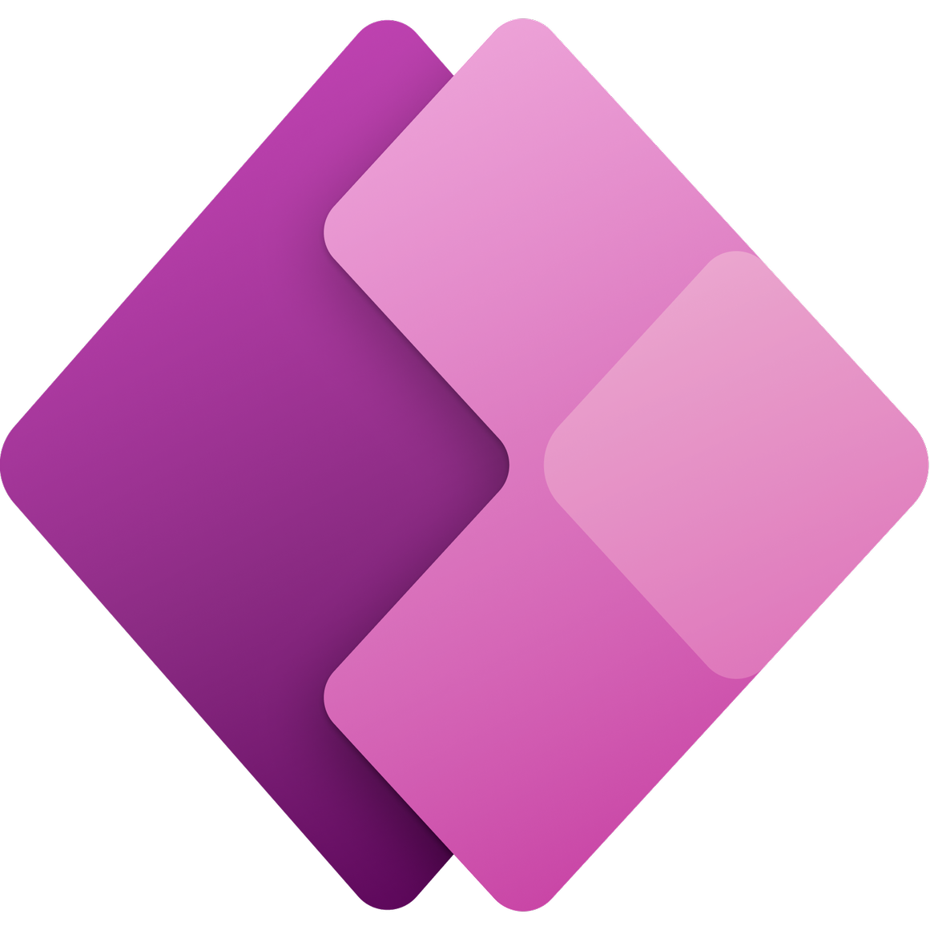

















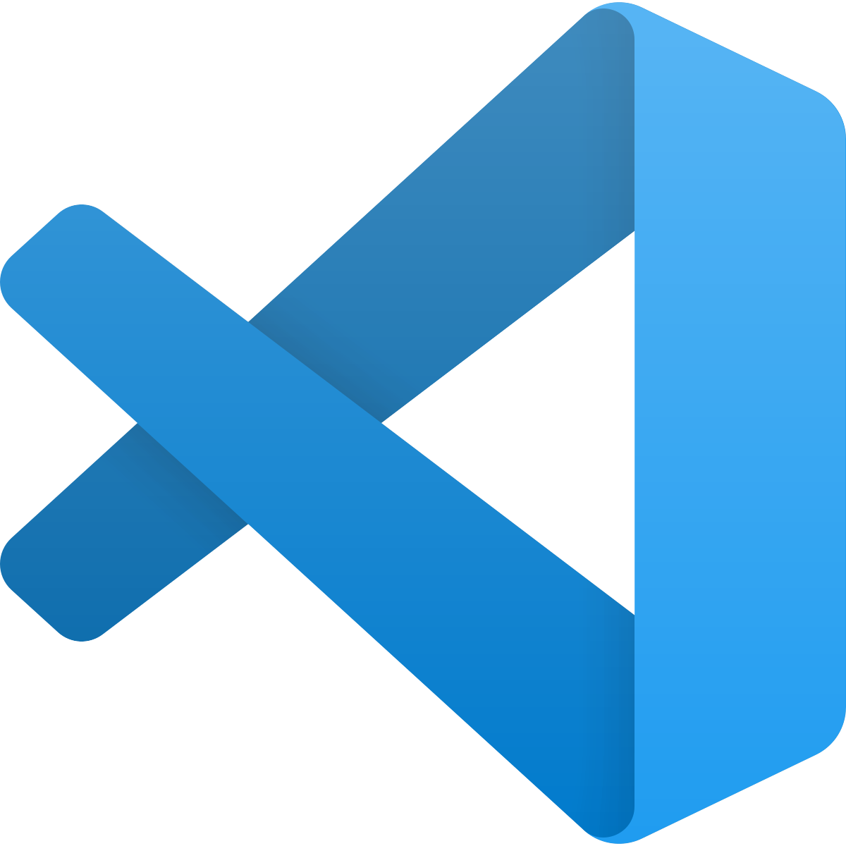
Develop faster than ever before with a composable cloud Pro Developers + Power Platform = No Limits
Power Platform
Every Developer (Low-Code)
Power BI
Business analytics
Power Apps
Application development
Power Automate
Workflow automation
Power Virtual Agents
Intelligent virtual agents
Power Pages business websites
GitHub
Azure services
Analysis
Services
API Management
Function
Apps
Kubernetes
Services
Logic
Apps
Cognitive Services
Bot
Services
Pro Developer (Code-First)
Azure
DevOps
Azure / Office
Data Services
Dataverse
Microsoft
Graph
SQL
Database
SQL Data Warehouse
Cosmos
Database
Visual
Studio
VS
Code

Slide 19
The platform extensibility model Power Platform across Microsoft 365, Dynamics 365, and Azure
Dynamics 365
Finance and operations
Dynamics 365
Marketing
Sales
Service
Talent
Office 365
LinkedIn
Ecosystem
ISV and custom apps
Power Platform
Web services
Power BI
Power Apps
Power Automate
Power Virtual Agents
Power Pages
User interface
Model apps + Canvas apps
Custom controls
Logic
Business rules + Flows + Plugins + Functions
Business rules
Plug-ins Automation
Data model
Entities + relationships
Metadata extensions
Custom connectors
Gateways + connectors
Notes:
Power Platform extensibility also extends to third party applications and other Microsoft business applications in Dynamics and M365.
With Power Platform, citizen developers and pro developers alike can create UX extensibility, logic extensibility and custom data models across different applications and systems.
You can extend and customize a Dynamics business application to meet the specific needs of your business. You can pull data from Salesforce to develop the solution you need or extend Adobe products based on the specific needs of your business. With 350+ different data connectors and seamless extensibility across common technology workloads, Power Platform offers low-code, high-speed development and customization option across your existing suite of business applications.

Slide 20

Accelerate code-first and low-code development
Leverage Azure to create rich customer experiences with managed services built for developers
Build apps faster, utilize pre-built UX, and point-and-click AI to accelerate frontends and business process development
Lower app development and maintenance costs by up to 74% by increasing development speed and leveraging out-of-box solutions
Notes:
In addition to being a powerful tool for Citizen Developers, Power Platform allows professional developers to leverage the efficiency of low code and the flexibility and resilience of Azure to create rich digital experiences with managed services built for them. ​
With Power Platform, teams can rapidly create web and mobile frontends or automate workflows using a drag and drop visual designer, no dev environment setup required​. Professional developers can also leverage pre-built UX components and can easily add AI capabilities with no ML expertise required. Any user can build and train AI models through a low-code, point-and-click experience in the cloud. ​
Power Platform is a powerful low-code and code-first environment for all developers, enabling faster and cheaper development across the business – ultimately driving more productivity and efficiency.

Slide 21

Build, deploy, and manage a governance system
Enable everyone to innovate with low-code tools in a secure and trusted environment
Develop a low-code Center of Excellence (COE) to nurture growth of low-code transformation by building guardrails and security standards
Drive flexible innovation by deploying and managing a governance system with confidence
Notes:
Microsoft is synonymous with security, and Power Platform is no different. From low-code solutions deployed by individual business users to enterprise-grade apps developed in Azure and Power Platform, everything is secure and governable.
Power Platform comes out of the box with data loss prevention policies, Azure Active Directory-enabled security models, manageable and governable environments, and the Power Apps Admin Center where all Power Platform applications can be managed and monitored.
On top of this, Power Platform comes with Center of Excellence and governance models that you can deploy in your business to ensure that governance processes are followed and that your business benefits from Power Platform.

Slide 22

Challenge 1 Power Platform Environment
Notes:
For each “mini-lecture”, have a topic title and/or sub-topic title.
Each mini-lecture should be no longer than 5-10 minutes in length.
Only deliver one lecture ahead of each challenge.
Do not attempt to present all of the lectures before students start hacking.

Slide 23

Challenge #1 Power Platform Environment
Evaluate requirements
Tailspin Toys scenario
Low code development platform
Provision trial environment
Create a Solution for development
Notes:
For each challenge, list out the key high-level goals.
If there are important specifications, list them here, or remind students to “read the student guide!”

Slide 24
Challenge 2 Build an AI Model to Extract Order Data
Notes:
For each “mini-lecture”, have a topic title and/or sub-topic title.
Each mini-lecture should be no longer than 5-10 minutes in length.
Only deliver one lecture ahead of each challenge.
Do not attempt to present all of the lectures before students start hacking.

Slide 25
Challenge #2 Build an AI Model to Extract Order Data
Explore AI Builder models
Pre-built models
Options for custom models
Extract Order data from pdf files
Notes:
For each challenge, list out the key high-level goals.
If there are important specifications, list them here, or remind students to “read the student guide!”

Slide 26
Challenge 3 Extract Order Data to Dataverse Using Power Automate
Notes:
For each “mini-lecture”, have a topic title and/or sub-topic title.
Each mini-lecture should be no longer than 5-10 minutes in length.
Only deliver one lecture ahead of each challenge.
Do not attempt to present all of the lectures before students start hacking.

Slide 27
Challenge 3 Extract Order Data to Dataverse Using Power Automate
Create required tables in Dataverse
Orders
Order Detail Lines
Leverage some standard tables
Create Power Automate Flow to process
Leverage AI Builder
Write data to Dataverse
Notes:
For each challenge, list out the key high-level goals.
If there are important specifications, list them here, or remind students to “read the student guide!”

Slide 28
Challenge 4 Approval Process
Notes:
For each “mini-lecture”, have a topic title and/or sub-topic title.
Each mini-lecture should be no longer than 5-10 minutes in length.
Only deliver one lecture ahead of each challenge.
Do not attempt to present all of the lectures before students start hacking.

Slide 29
Challenge 4 Approval Process
Evaluate Order amount
Conditions for approver
Handle notifications
Start and wait for approval
Deploy approval solution
Send order confirmation
Notes:
For each challenge, list out the key high-level goals.
If there are important specifications, list them here, or remind students to “read the student guide!”

Slide 30
Challenge 5 Build a Power App
Notes:
For each “mini-lecture”, have a topic title and/or sub-topic title.
Each mini-lecture should be no longer than 5-10 minutes in length.
Only deliver one lecture ahead of each challenge.
Do not attempt to present all of the lectures before students start hacking.

Slide 31
Challenge 5 Build a Power App
Import base canvas app
Create screens, navigation elements
Buttons for additional functions
Notes:
For each challenge, list out the key high-level goals.
If there are important specifications, list them here, or remind students to “read the student guide!”

Slide 32
Challenges 6 - 9 Teams Integration Power BI Reporting & Integration Power Virtual Agent Chatbot Application Lifecycle Management
Notes:
For each “mini-lecture”, have a topic title and/or sub-topic title.
Each mini-lecture should be no longer than 5-10 minutes in length.
Only deliver one lecture ahead of each challenge.
Do not attempt to present all of the lectures before students start hacking.

Slide 33
Challenges 6,7,8,&9 More
Teams Integration
Create Team
Embed app
Power BI
Create data model and visualizations
Embed in Tailspin Toys’ App
Power Virtual Agent
Handle FAQs
Respond to order queries
Application Lifecycle Management
Review and check solution
Plan for export and import to test environment
Notes:
For each challenge, list out the key high-level goals.
If there are important specifications, list them here, or remind students to “read the student guide!”

Slide 34
Get started with Power Platform
Introduction to Power Platform
Information for advanced users
Admin, Governance, & IT
Overview: Power Platform Overview
Training Labs: Apps in a Day | Flow in a Day | Power Virtual Agents in a Day | More Power Platform labs
Power Platform Guidance: Documentation | Architecture video series
YouTube channels: Power Platform | Power Apps | Power Automate | Power BI | Power Virtual Agents
Community: Power Apps community | Power Automate community | Power Virtual Agents community | AI Builder community
Expert help from partners: https://powerapps.microsoft.com/partners/
Understanding Power Platform licensing
Product Demos at cdx.transform.Microsoft.com
Power Platform sessions from Ignite 2020
The Return to the Workplace Solution, built on Power Platform
Teams and Power Platform – Project Oakdale
Latest updates: October 2020 Virtual Launch event | Demo by Charles Lamanna
Power Platform Release Waves: Wave 1 (Apr 202 – Sep 2020) | Wave 2 (Oct 2020 – Apr 2021)
Latest shipped features: Weekly release notes | Power Apps – Apr 2020 summary | Power Automate – RPA General Availability
Conference sessions: Power Platform Online Conference 2020 | Ignite 2020 | Microsoft Business Applications Summit 2020
Power Automate how-to videos: webinars and videos gallery
Additional labs: Power Platform labs and challenges | Power Platform labs
Power Platform technical documentation
MS Learn Resources
Power Platform and Azure
Administration, governance, and ALM: Documentation | Blog posts | MBAS 2019 sessions | Managing and supporting Power Apps and Power Automate at Scale (Ignite 2019) | New Data Loss Prevention capabilities
Establishing a Center of Excellence: Center of Excellence Starter Kit
Admin and governance best practices: Establishing an Environment Strategy
Administering a Power Apps enterprise environment: Blog | Download whitepaper
Build a customized Admin experience using the Power Apps admin connectors: blog post with sample admin dashboard | admin connector documentation
Security and certifications: Microsoft Trust Center
Pricing and licensing: Summary | Licensing documentation
Visit Power Platform for additional information
Notes:
https://powerapps.microsoft.com/en-us/blog/microsoft-powerapps-learning-resources/

Slide 35
Thank You for Attending! https://aka.ms/wth
Notes:
Thank students for attending and share the link to the What The Hack website with them.

